Slide 1
Lecture Objectives
Understand the structure of the three filaments of the cytoskeleton
Understand the basic functions of the three filaments of the cytoskeleton
Undertsand the differences and similarities between the three filaments of the cytoskeleton

Slide 2
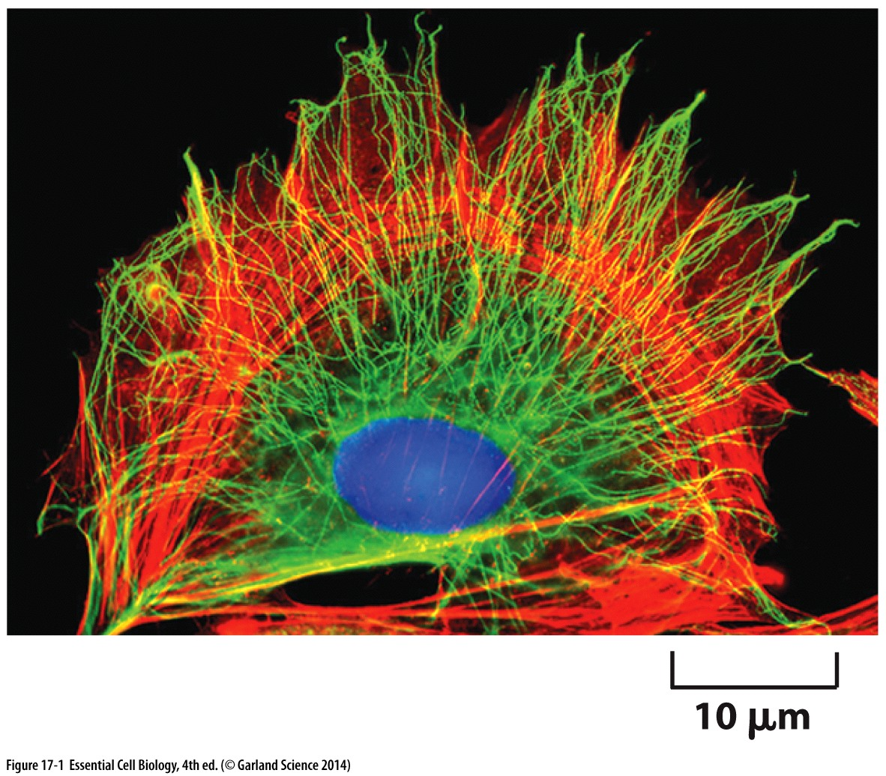
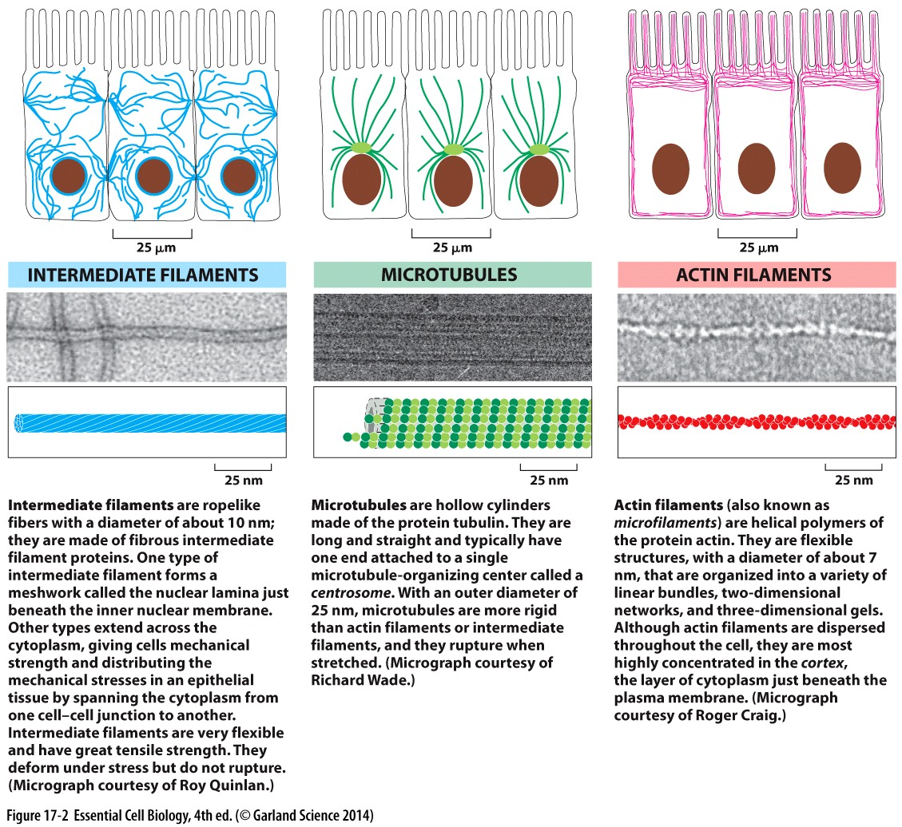
Filaments of the Cytoskeleton
Give the cell shape
Allows the cell to organize components
Permits movement
Actin & microtubules in all eukaryotic cells
Intermediate filaments:
in soft bodied animals cells
Cells that need strength

Slide 3
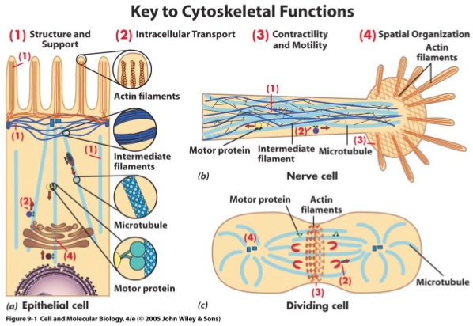

Slide 4
Intermediate filaments

Slide 5
Intermediate filaments

Slide 6
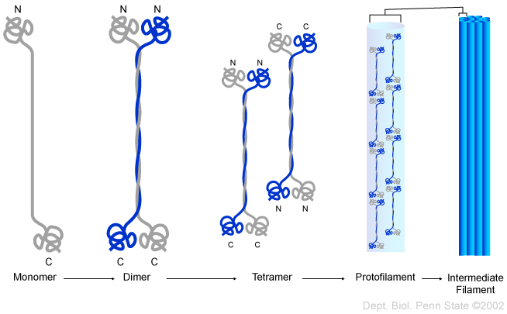
Intermediate filaments: structure
Two monomers → dimers

Slide 7
Intermediate filaments: structure
Bi-directional:
Both ends are the same
Two monomers → dimers
Two dimers → tetramer with staggered antiparallel ends

Slide 8
Intermediate filaments: structure
Non covalent interactions:
Sum of many weak bonds = strength
Two monomers → dimers
Two dimers → tetramer with staggered antiparallel ends
Strong and rope like: stable, deform under stress but do NOT rupture

Slide 9
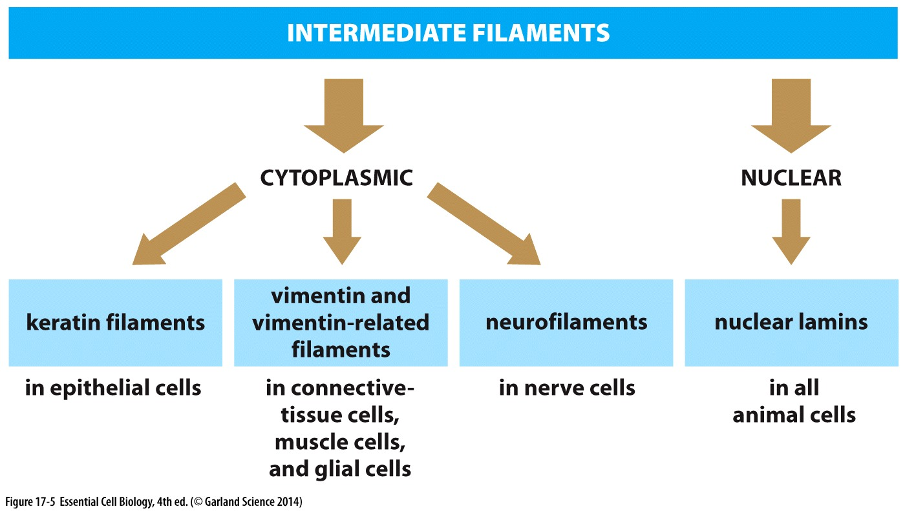
Intermediate filaments: 4 classes
1 2 3 4

Slide 10
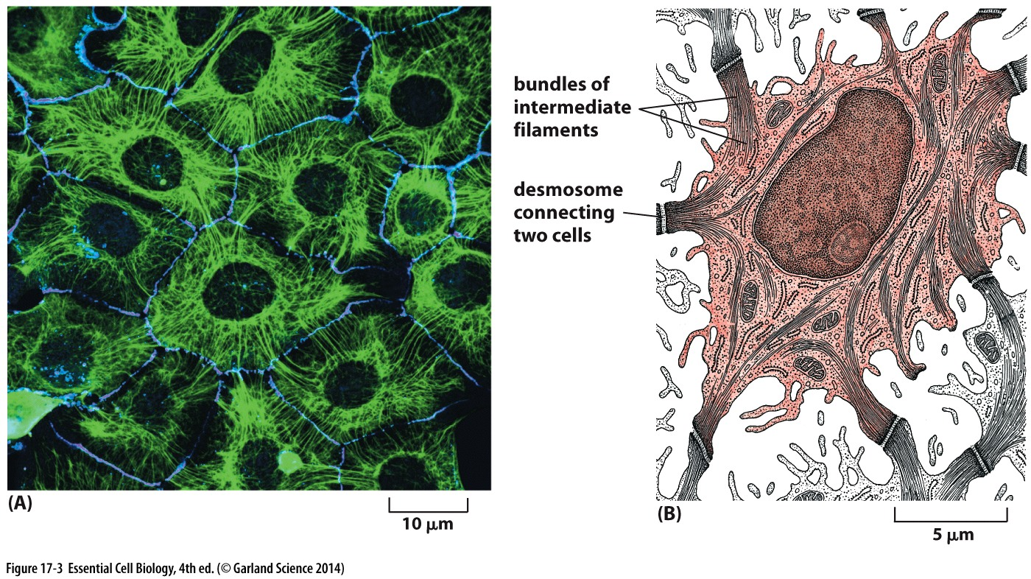
Cytoplasmic lamins: function
Strong, flexible and ropelike
Network extending across the cytoplasm & cross-linked together
Indirect connections between intermediate filaments of neighboring cells (desmosome): distributes mechanical stress

Slide 11
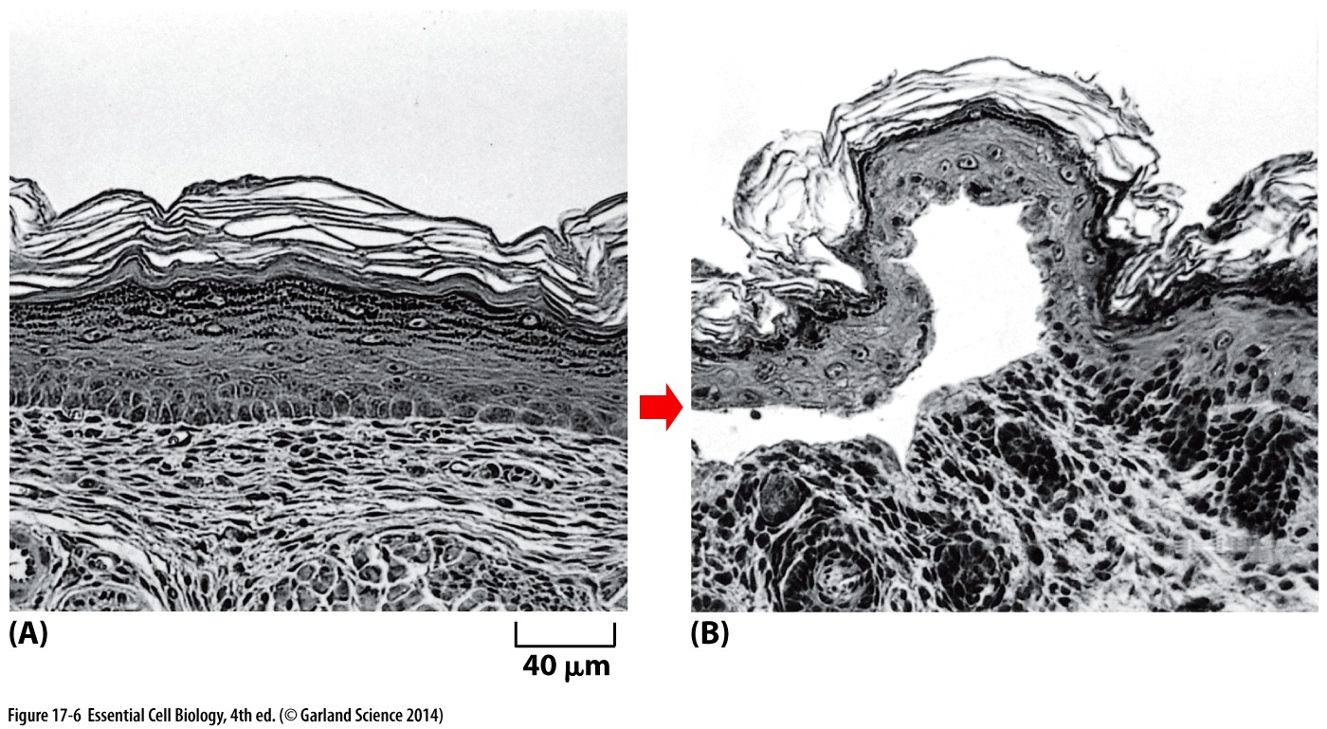
Keratin mutants compromise skin integrity
Rupturing of cells causes blistering
Keratin allows skin to stretch and experience mechanical stress without tearing/rupturing cells
When keratin filaments are disrupted→ light touch ruptures cells

Slide 12
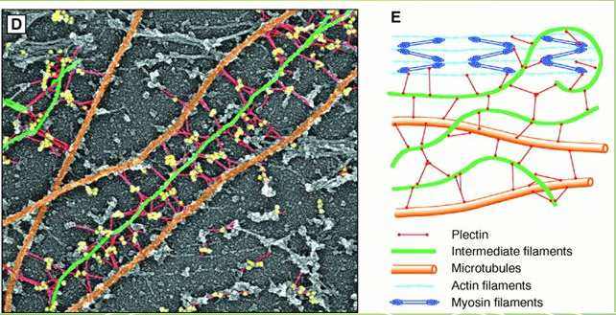
Cytoplasmic lamins: function
Scaffold:
associate with plasma membrane & other cytoskeleton components (actin & microtubules)
organize intracellular structure
Attach to nuclear envelope: position & anchor the nucleus

Slide 13
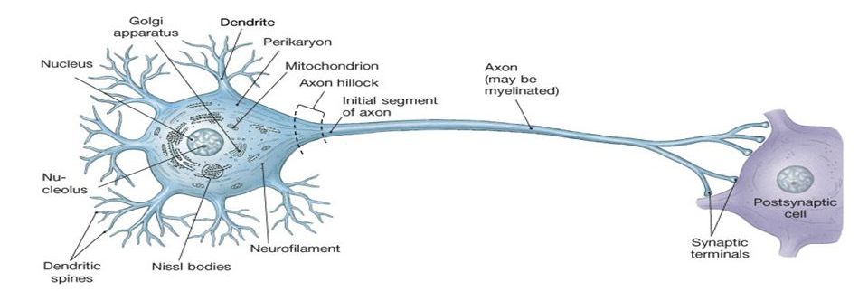
Cytoplasmic lamins: function
Neurofilaments: major components of neuron cytoskeleton Supports shape and structure of the cell body and axon
Longest from base of spine to big toe: can be 3+ feet long

Slide 14
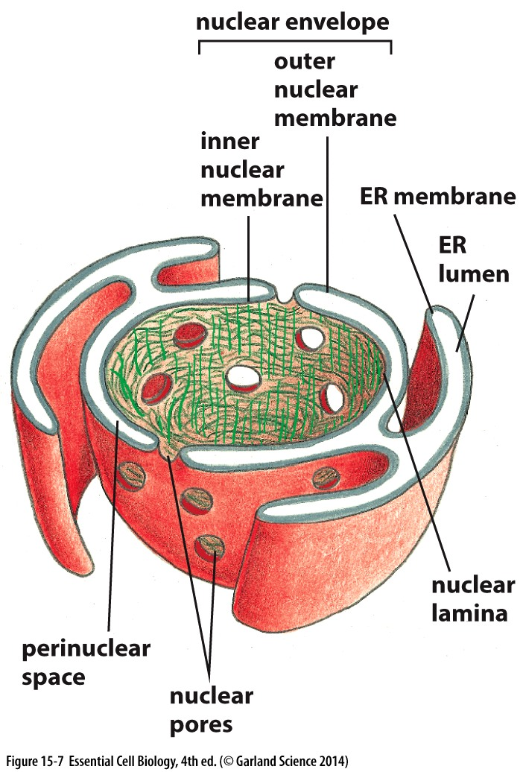
Nuclear lamins
Supports the nuclear membrane
Proteins in the inner nuclear membrane are secured in place by scaffold proteins in the nucleus

Slide 15
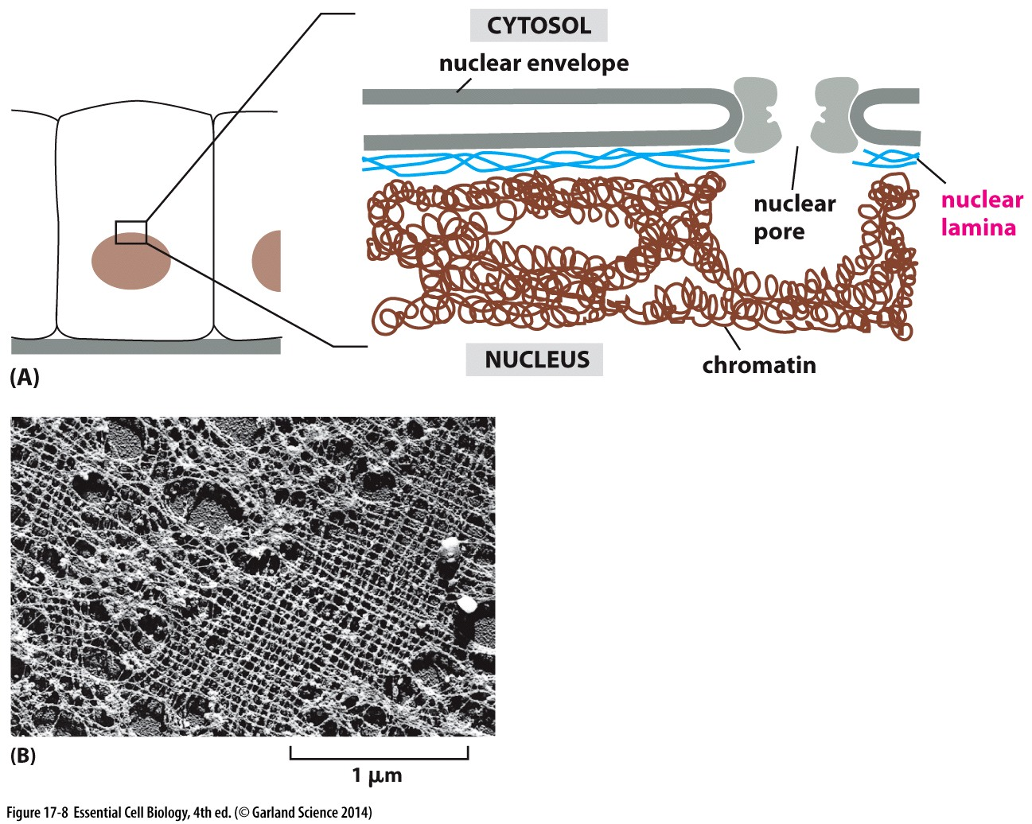
Nuclear lamins
Supports the nuclear membrane
Proteins in the inner nuclear membrane are secured in place by scaffold proteins in the nucleus
Lamins are this scaffold
Lattice associated with nuclear side of the inner membrane
Electron micrograph of nuclear lattice

Slide 16
microtubules

Slide 17
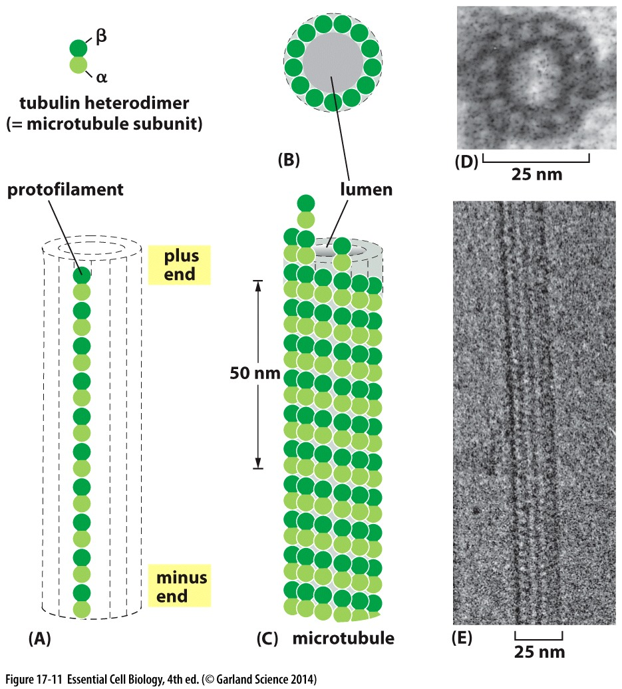
Microtubules: structure
Polar
α tubulin + β tubulin = heterodimer
Assemble end to end
Protofilaments associate laterally
Two ends are structurally distinct
+ end: β tubulin
- end: α tubulin

Slide 18
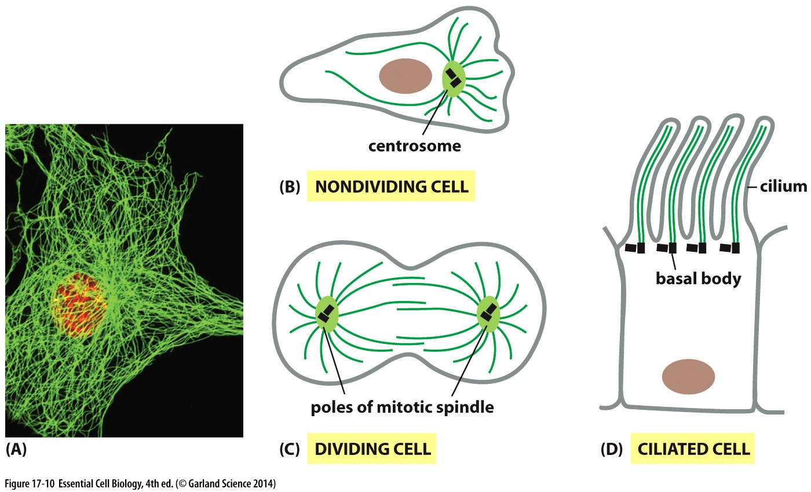
Microtubules: nucleation & growth
Grow from an organizing center: centrosome
Centrosome:
One in non-dividing cell
Two in mitotic cells (poles of mitotic spindle)
Base of cilia and flagella

Slide 19
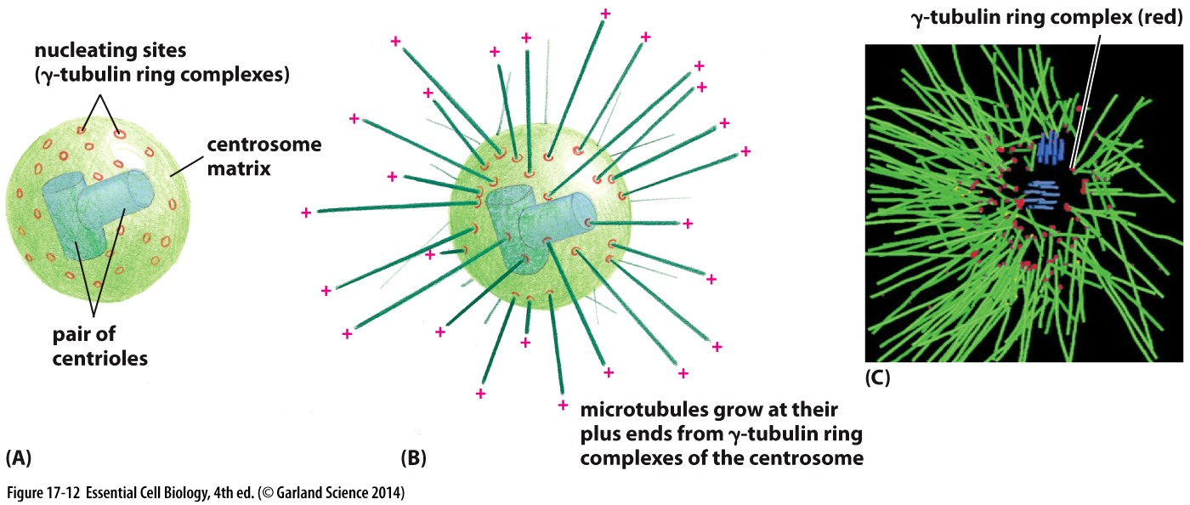
Microtubules: nucleation & growth
Microtubule growth is initiated from γ tubulin ring complexes at centrosomes
New growth happens as dimers added to + end

Slide 20
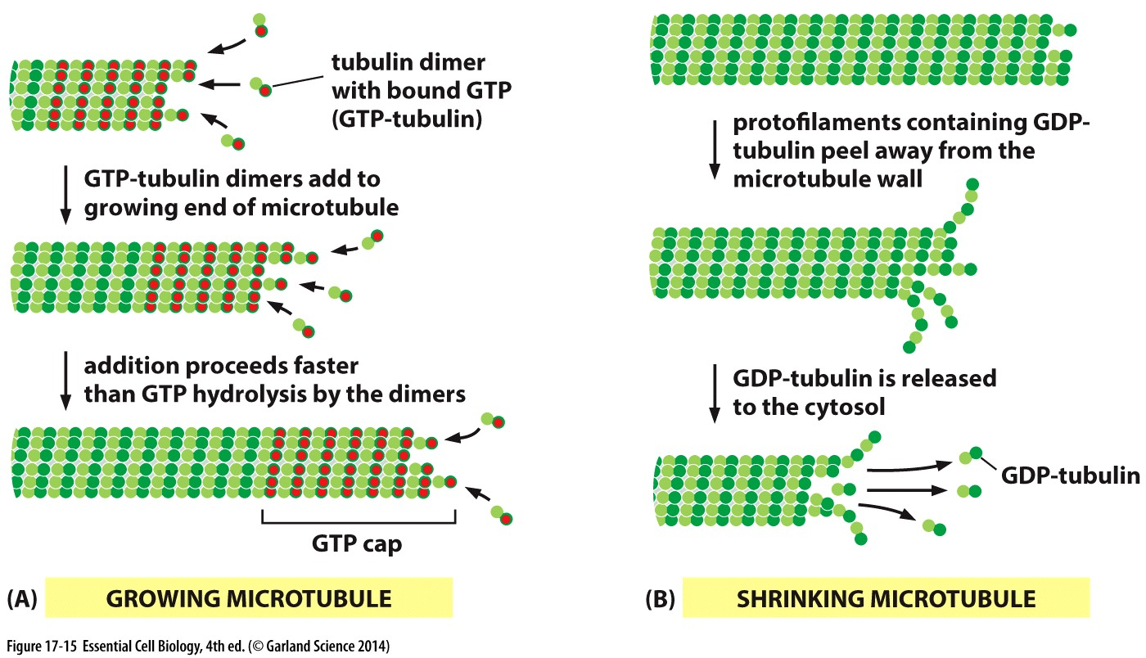
Microtubules: grow
http:/%2Fwww.youtube.com%2Fwatch%3Fv%3D21P100yiEN8
α tubulin binds GTP: does not hydrolyze
β-tubulin binds GTP: can be hydrolyzed
→ GTP-bound dimers: grow
→ GDP-bound dimers: shrink
Tubulin binds GTP → hydrolysis regulates assembly/disassembly
When addition of GTP dimers is faster than hydrolysis (GTP cap) → grows

Slide 21
Microtubules: grow and shrink
Tubulin binds GTP → hydrolysis regulates assembly/disassembly
When addition of GTP dimers is faster than hydrolysis (GTP cap) → grows
When hydrolysis is faster, GDP dimers fall off → shrinks

Slide 22
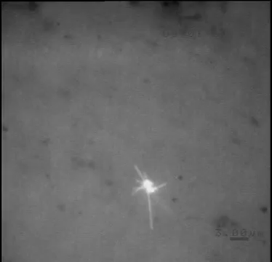
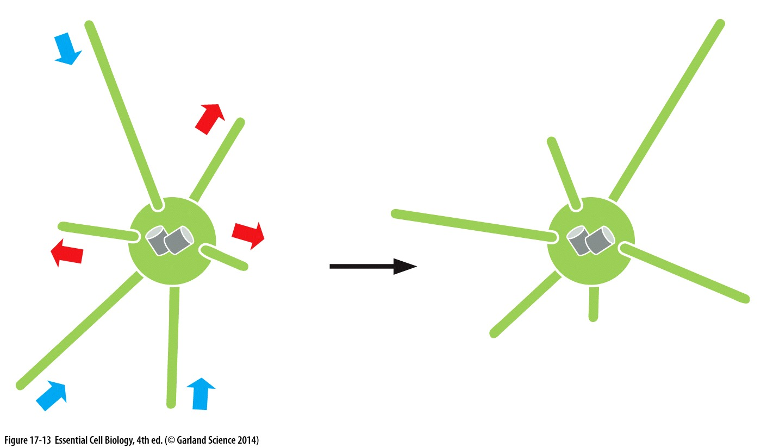
Microtubule: dynamic instability
Rapid cycles of growth and shrinkage→ dynamic instability
Neighboring microtubules grow and shrink independent of each other

Slide 23
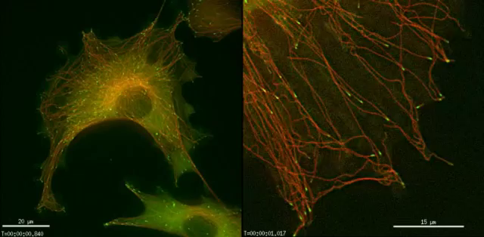
Dynamic Instability
Microtubles are more dynamic near the cell edge
→ necessary to allow microtubules to reach the cortex
Microtubules stability is regulated by microtubule associated proteins (MAPs)
Bind tips and promote growth

Slide 24
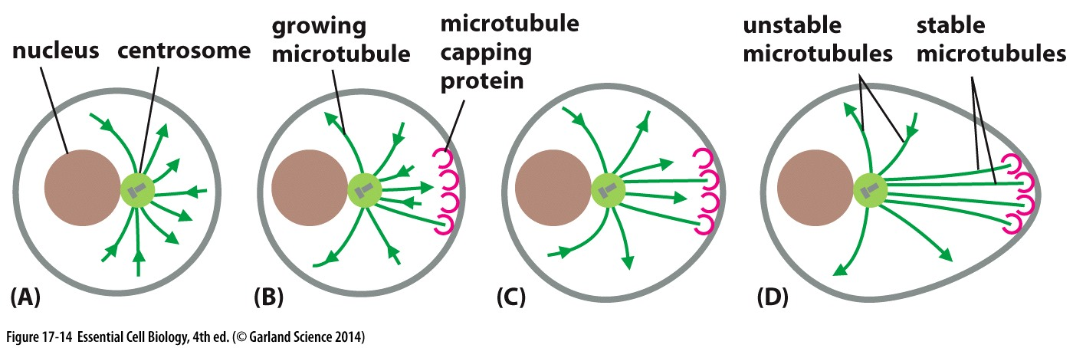
Dynamic Instability
Microtubles are more dynamic near the cell edge
→ necessary to allow microtubules to reach the cortex
Microtubules stability is regulated by microtubule associated proteins (MAPs)
Bind tips and promote growth
Bind tips and promote disassembly
Bind tips and stabilize

Slide 25
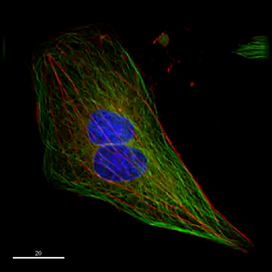
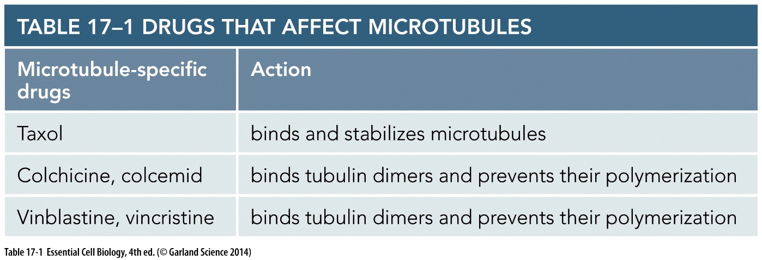
Drugs that impact microtubules
Drugs or proteins that bind tubulin dimers can interfere with dynamic instability
→ compromised microtubule structure and function

Slide 26
Microtubule function

Slide 27
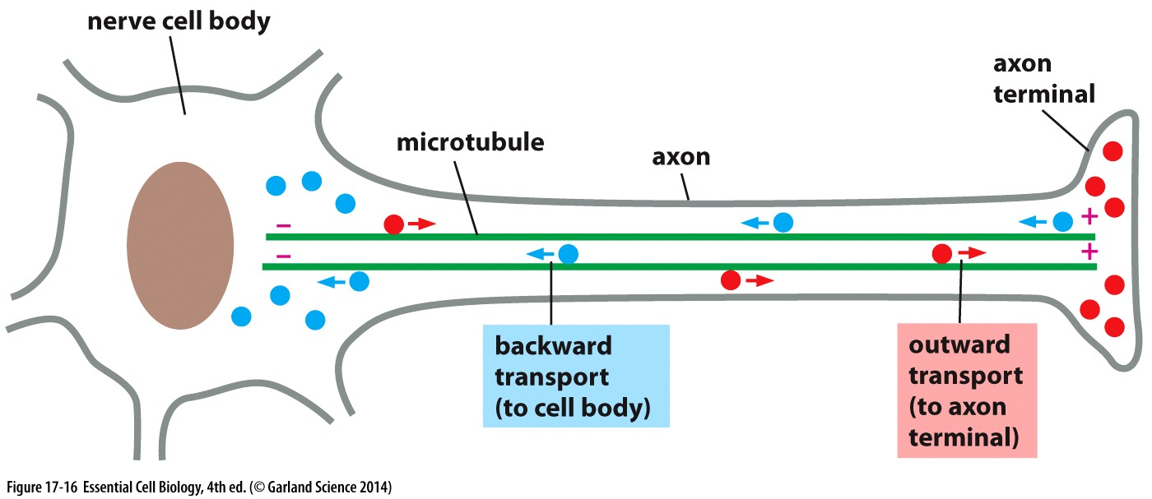
Microtubules as tracks
Motor proteins travel on microtubules to transport cargo
Includes organelles, vesicles

Slide 28
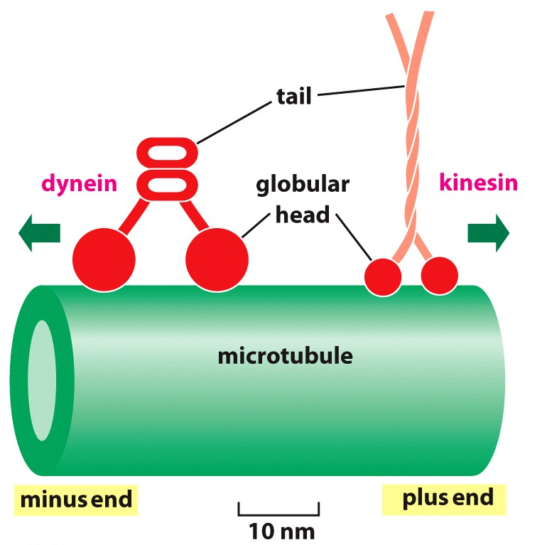
Microtubules as tracks
Polarity of microtubules (α-tubulin at one end, β tubulin at other) allows motor proteins to be directional
Dynein → towards minus end
Kinesin → towards plus end

Slide 29
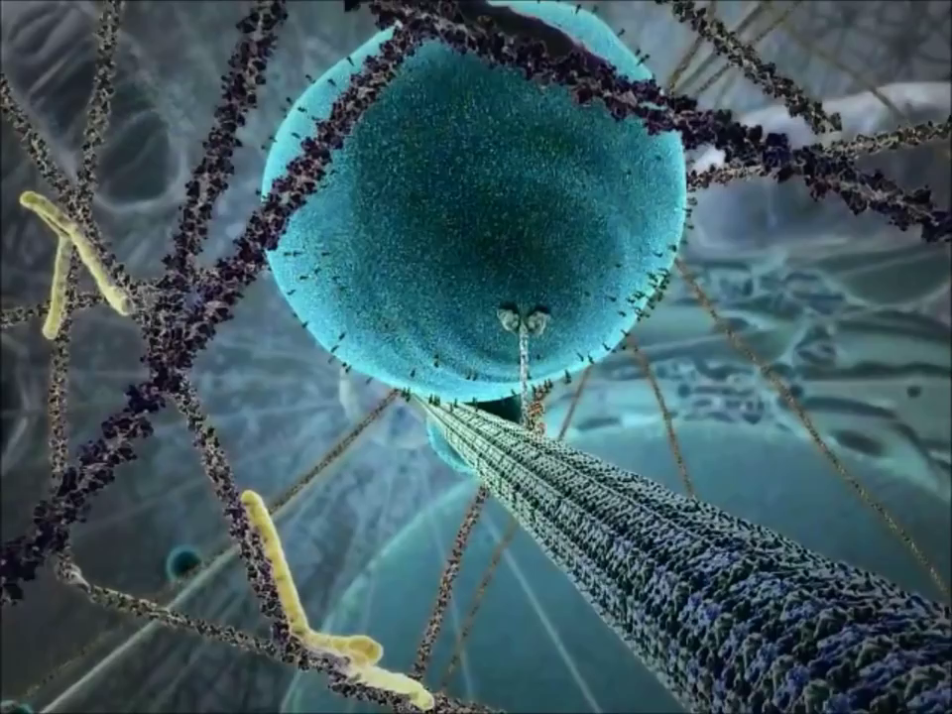
Microtubules as tracks
Vesicles for projection growth
Vesicles for protein trafficking
Organization of cell (organelles) after cell division
Polarity of microtubules (α-tubulin at one end, β tubulin at other) allows motor proteins to be directional
Dynein → towards minus end
Kinesin → towards plus end

Slide 30
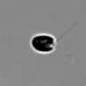
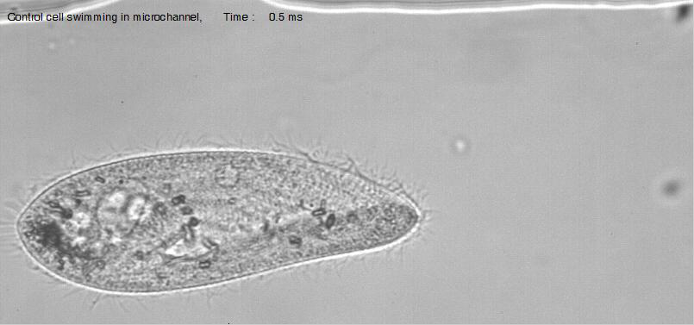
Motors move microtubules
Cilia and Flagella
Microtubule structures that are motile
Specialized microtubule structure

Slide 31
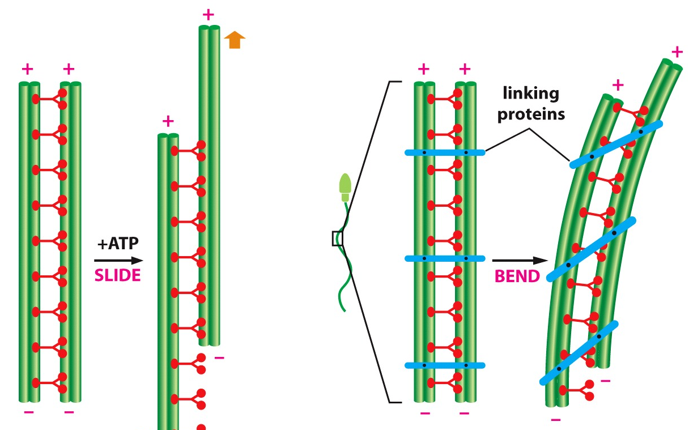
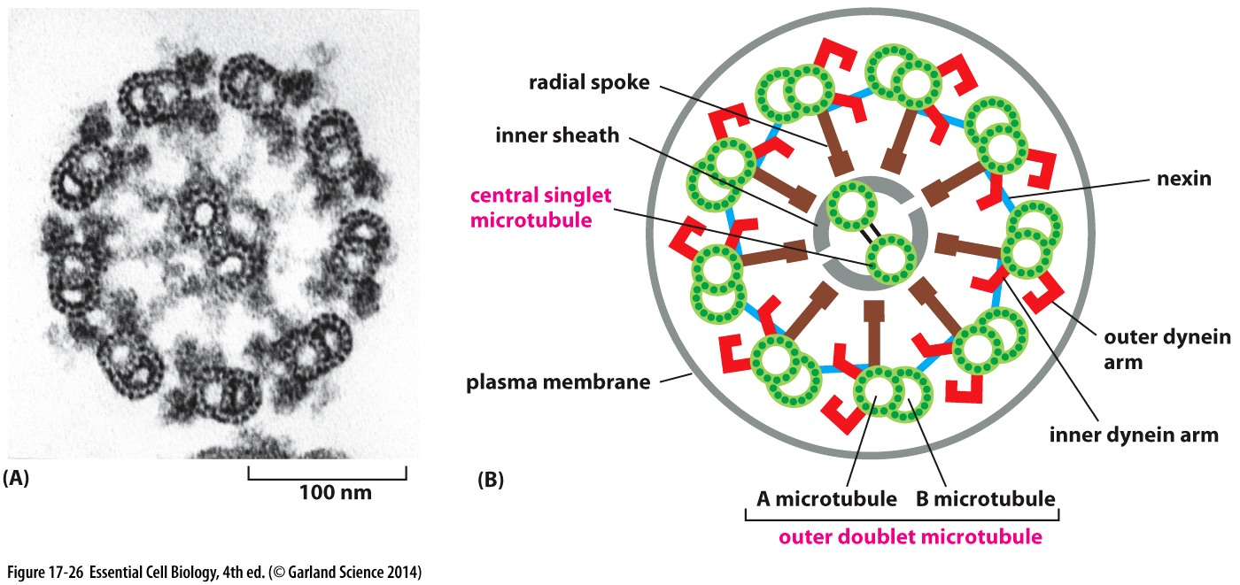
Motors move microtubules
Cilia and Flagella
Microtubule structures that are motile
Specialized microtubule structure (9 outer doublets+2 central)
Microtubules are stable and crosslinked together (nexin)→ moved by dynein causes to bend

Slide 32

Microtubule depolymerization moves chromosomes
Mitotic chromosomes attach to microtubules at distinct sites (small green foci)
Force of depolymerizing microtubules pull chromosomes during mitosis

Slide 33
Ways microtubules move things:
Motors walk on them: transport vesicles, organelles, etc
Motors move/bend microtubules: cilia and flagella
Depolymerizing microtubules generates pulling force: mitotic chromosomes

Slide 34
Actin filaments

Slide 35
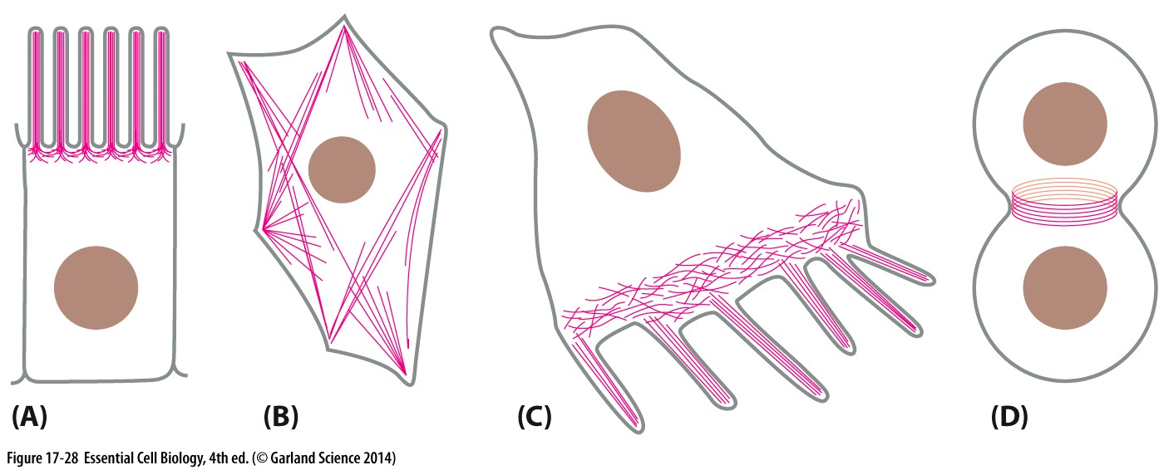
Actin filaments have diverse functions and localizations
Microvilli: sense and signal environment
Contractile bundles (stress fibers): “tiny muscles”
Filopodia: during movement at leading edge (front)
Contractile ring: to pinch off daughter cells during cell division
stable
dynamic

Slide 36
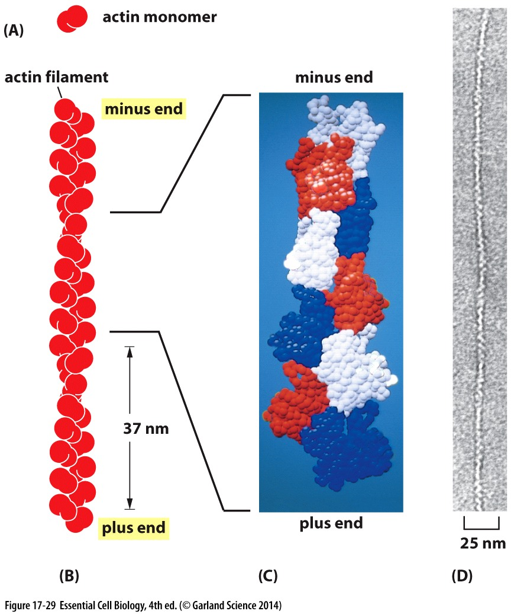
Actin filaments: structure
Thin and flexible
Made of monomers

Slide 37
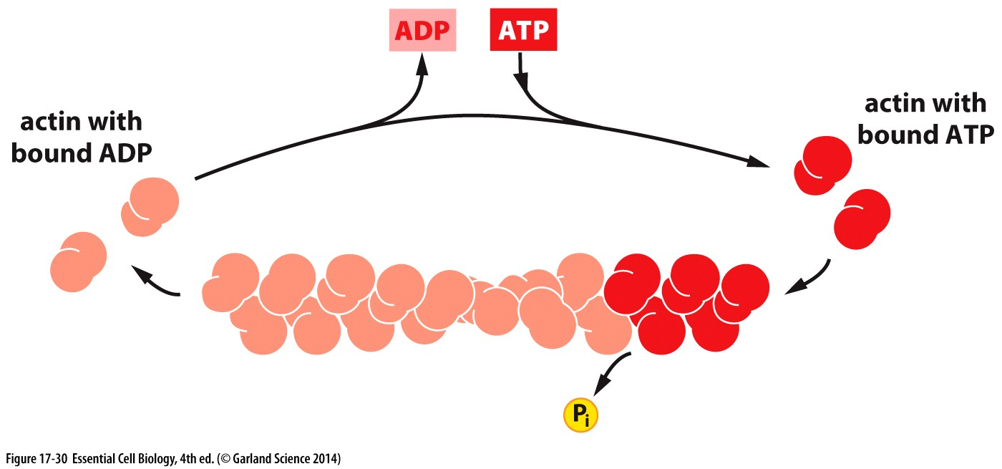
Actin filaments: structure
Thin and flexible
Made of monomers
→ polymerization is regulated by ATP hydrolysis
ATP bound monomers polymerize
ADP bound monomers disassemble

Slide 38
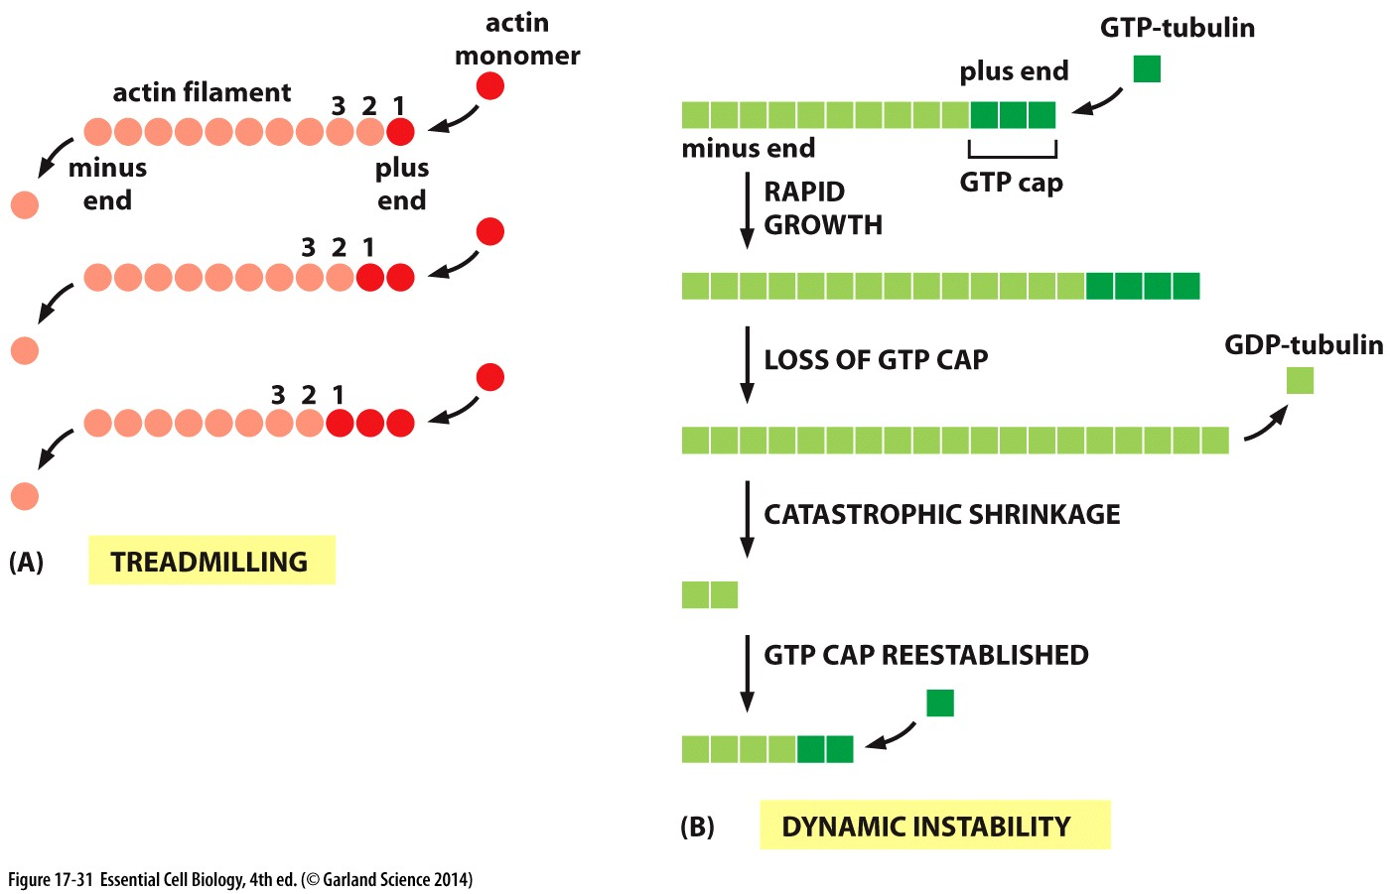
Actin: assembly and disassembly
Monomers add at the + end
Monomers disasemble at the minus end
→ treadmilling
(distinct from dynamic instability in MTs)
microtubules

Slide 39
Actin function

Slide 40
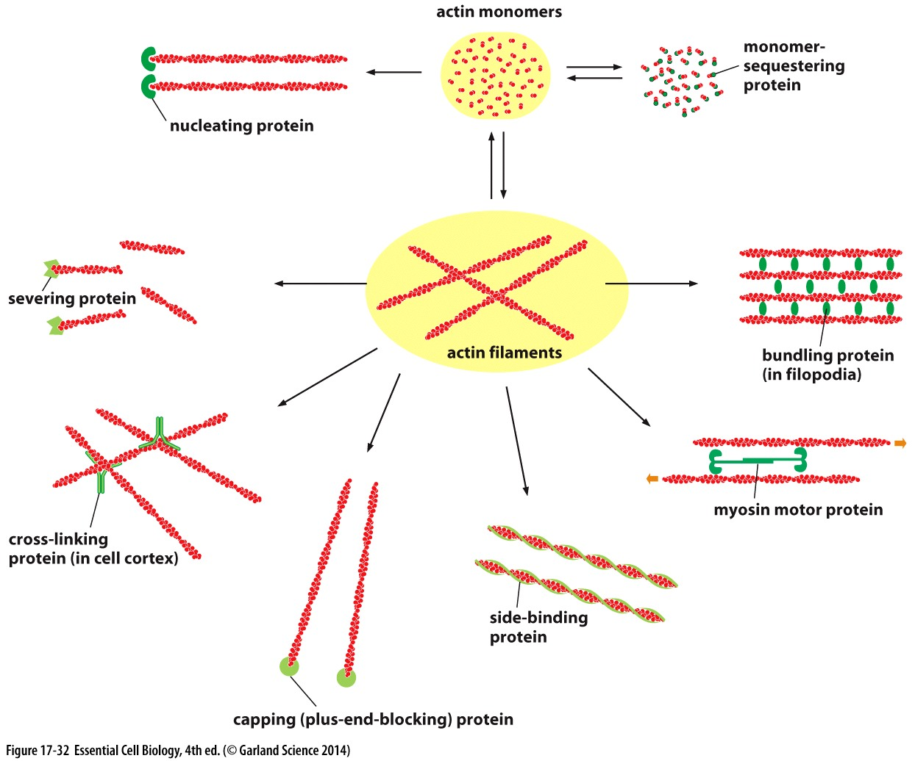
Actin structures
Can be interrupted by actin-binding molecules and drugs
Provide structure and support & tracks for transport
Can be harnessed to generate movement
New plus ends to grow

Slide 41
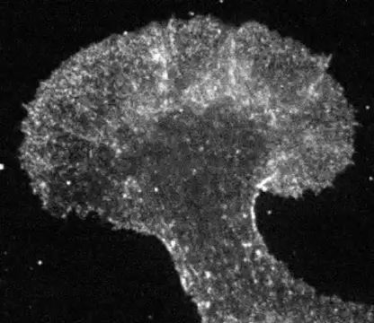
actin dynamics
Treadmilling can be harnessed to generate movement

Slide 42
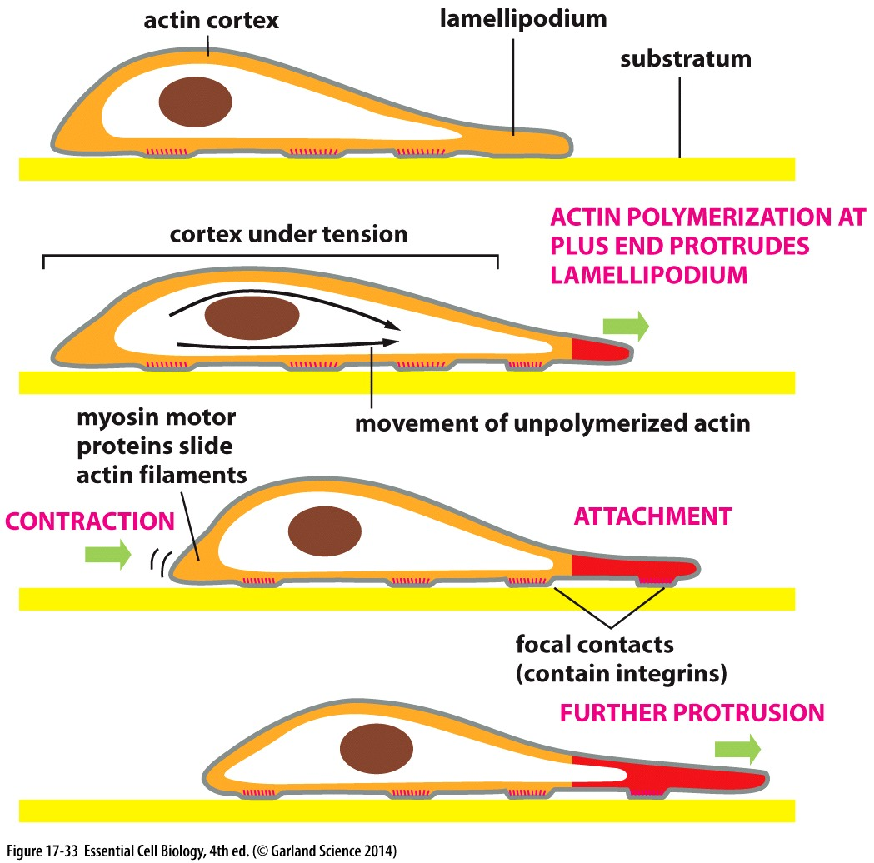
Cell motility
Polymerizing actin pushes cell membrane forward
Focal contacts form to generate resistance against surface →pulled forward
Actin filaments slide or are disassembled in the rear
→ cell moves forward

Slide 43
Cell motility
Green: actin
Red: focal adhesions
Coordination of different actin structures:
Focal adhesions and stress fibers → stength and structure
Lamellapodia→ wave-like leading edge
Filopodia → extent beyond the leading edge

Slide 44
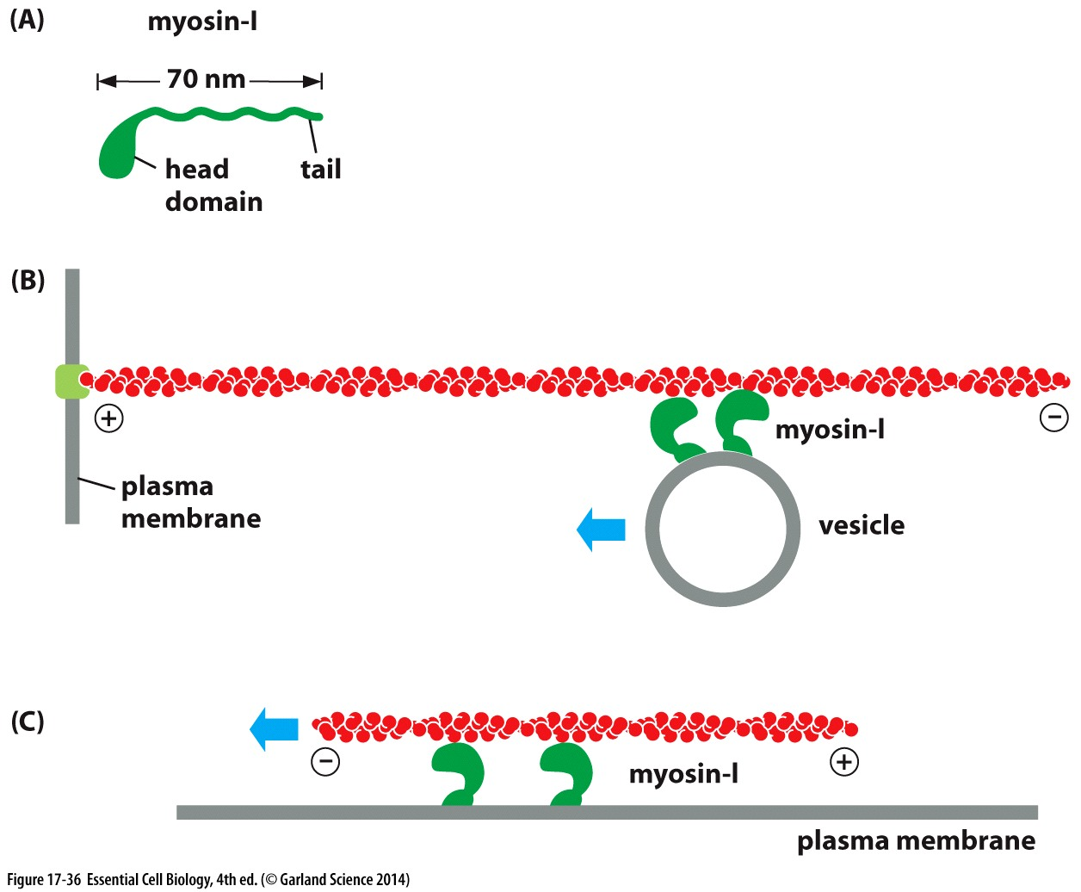
Actin tracks
Myosin motors move towards actin plus end
When motor is free/actin stationary
→ Move cargo towards plus end
When motor stationary/actin free
→ translocate actin filament towards minus end

Slide 45
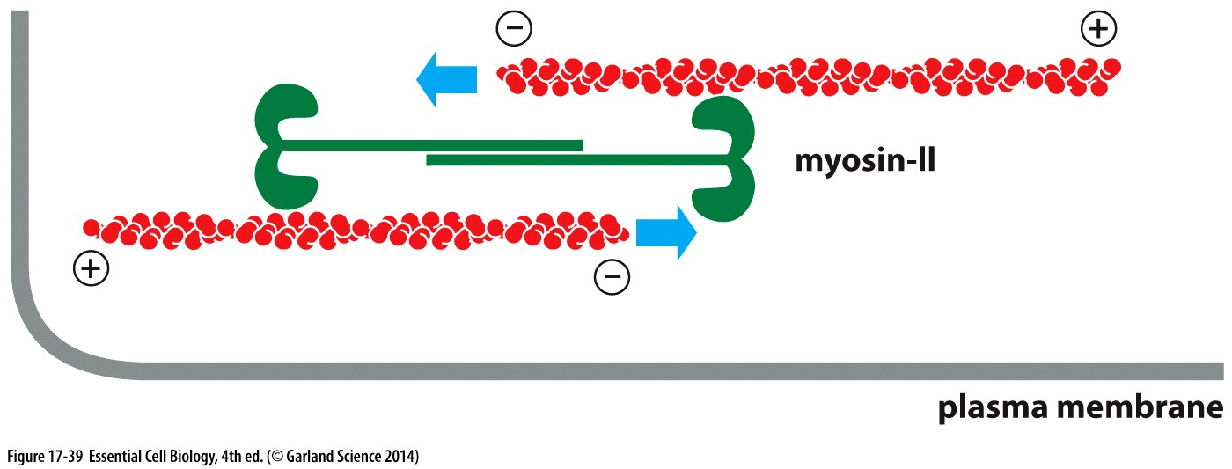
Actin in muscles
Myosin dimers can pull antiparallel actin filaments towards each other

Slide 46
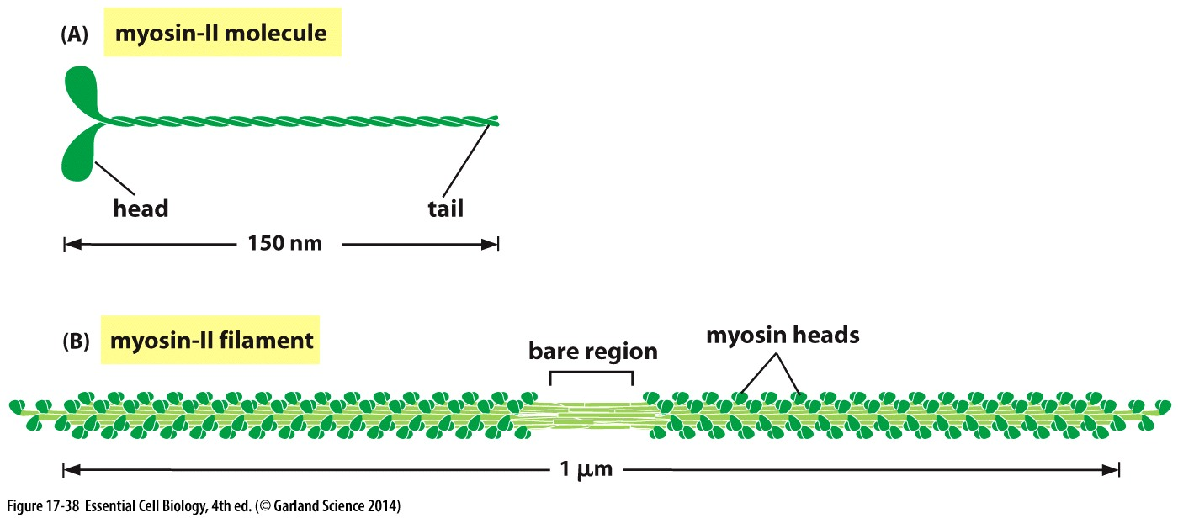
Actin in muscles
Myosin dimers can pull antiparallel actin filaments towards each other
Myosin II can oligomerize into a filament

Slide 47
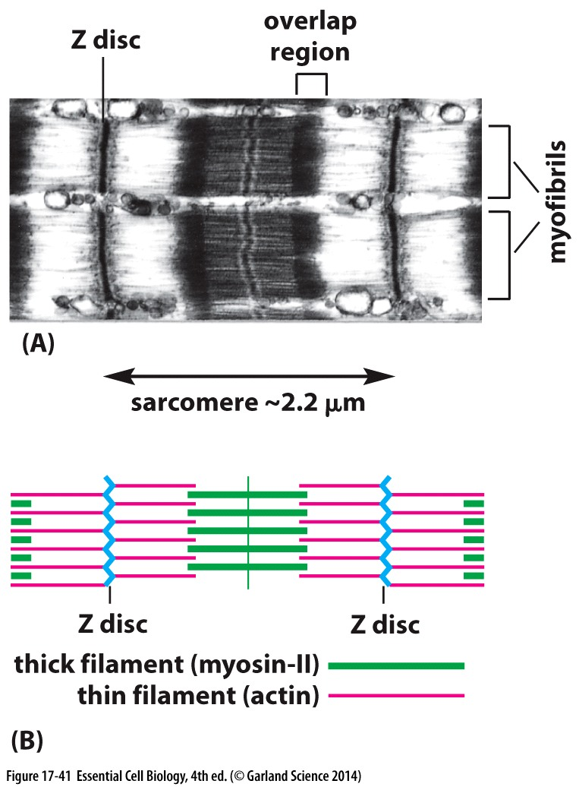
Actin in muscles
Myosin dimers can pull antiparallel actin filaments towards each other
Myosin II can oligomerize into a filament
Antiparallel actin bundles anchored via Z disk
Alternating units of actin and myosin filaments = sarcomere
Minimum contractile unit of muscle

Slide 48
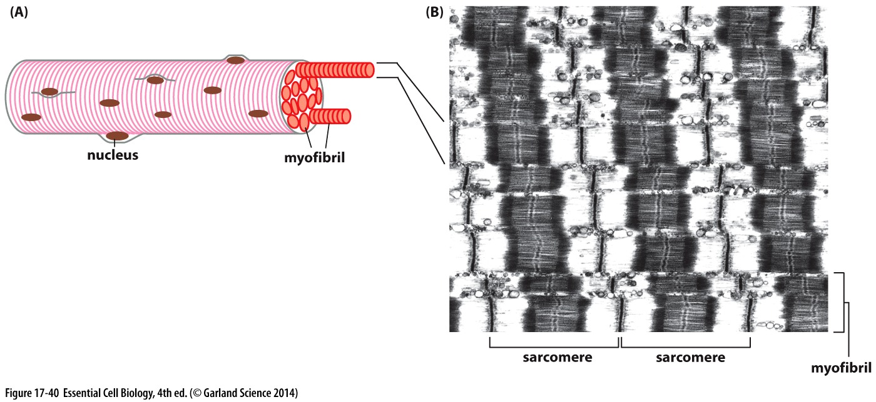
Actin in muscles
Myosin dimers can pull antiparallel actin filaments towards each other
Myosin II can oligomerize into a filament
Antiparallel actin bundles anchored via Z disk
Alternating units of actin and myosin filaments = sarcomere
Minimum contractile unit of muscle
Skeletal muscle: packed repeating actin/myosin sarcomeres

Slide 50
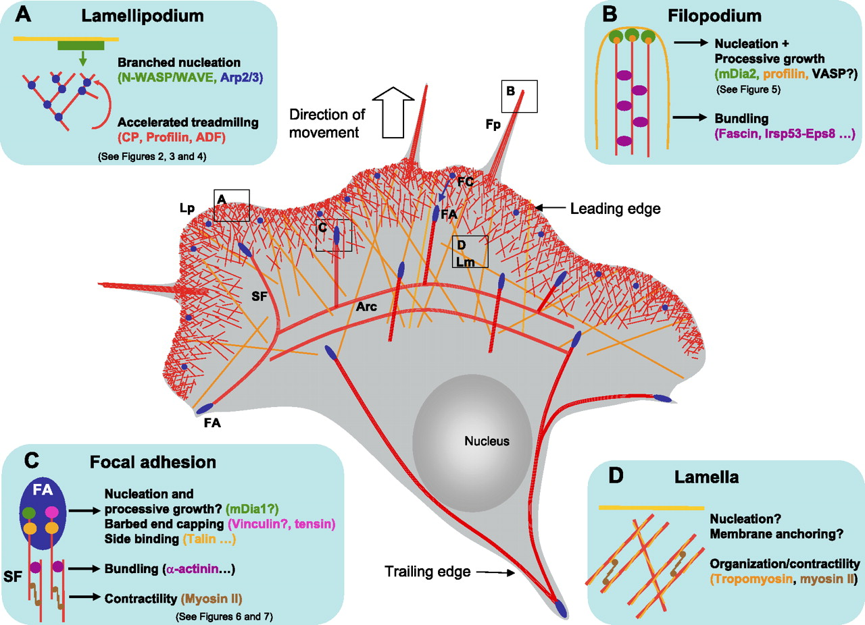
Cell motility
Different actin structures for different functions

